Slide 1

Natural Language Processing Techniques
for Identifying Bacteriocins
Master thesis, Lasse Buur Rasmussen
Supervised by Asker Daniel Brejnrod
and Mani Arumugam

Slide 2
Background
Antibiotics
Antibiotic-resistant bacteria
Long-lasting alterations of gut microbiome
Bacteriocins
Small antimicrobial peptides ribosomally synthesized by bacteria
Hamid et al. neural models & Word2Vec embedding
High performance - challenge traditional bioinformatic classification methods.
ELMo advantages
Word2Vec underlying assumption – words single context.
Multiple representations each word.

Slide 3
Main findings
Increased accuracy with ELMo embedding.
Hamid et al. test accuracy 86.0%.
Our classifier test accuracy 94.8%.
Found 40 putative bacteriocins.

Slide 4
Contents
Part 1
Searching for good encodings
Selecting best encodings
Part 2
Combining encodings with neural networks
Part 3
Applying the model

Slide 5
Contents
Part 1
Searching for good encodings
Selecting best encodings
Part 2
Combining encodings with neural networks
Part 3
Applying the model

Slide 6
Encoding Biological Sequences
Why?
Machines like numbers
Quantative rather than categorical

Slide 7
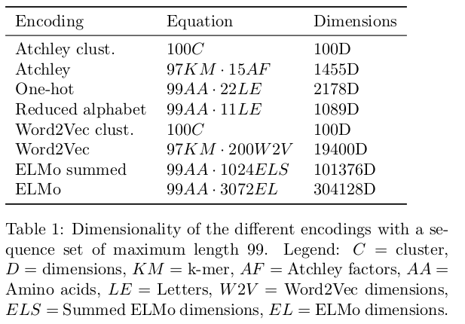
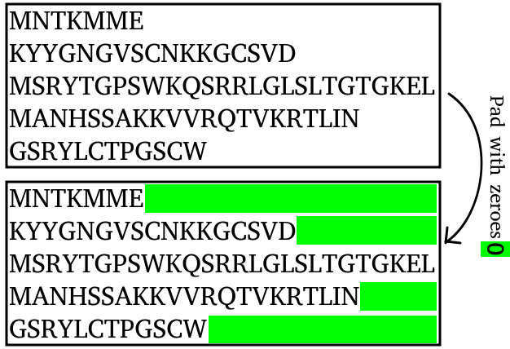
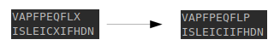
Encodings used
Sample dimensionality for 99 amino acids long sequence
Sequences with different lengths
Sequences containing X

Slide 8
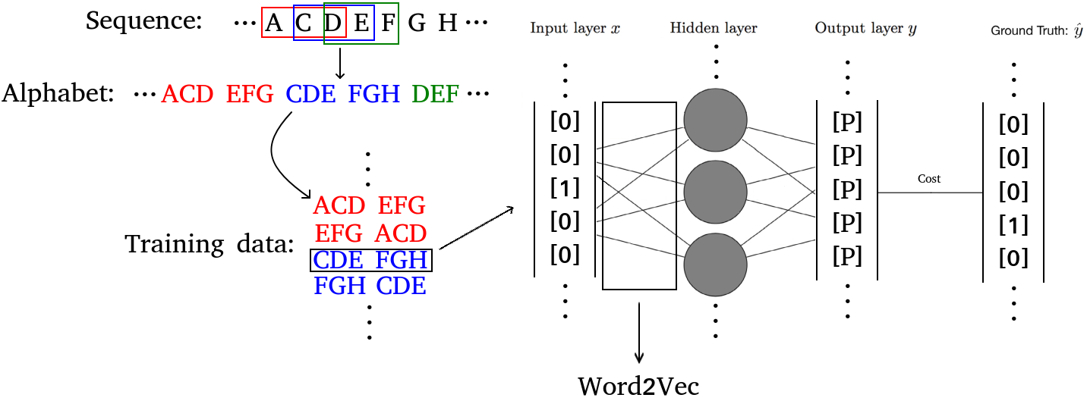
Amino Acids to K-Mers

Slide 9
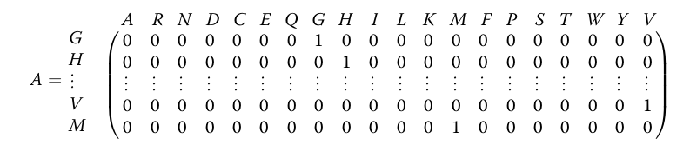
One-Hot Encoding

Slide 10
Encodings used
Polarity
Secondary structure
Molecular volume
Codon diversity
Electrostatic charge

Slide 11
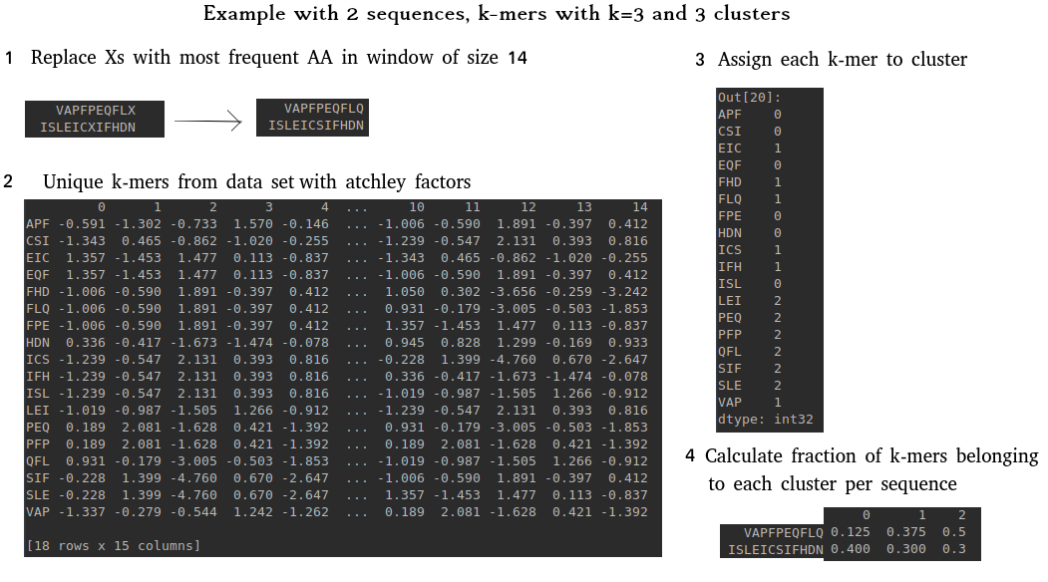
Atchley Factors Encoding

Slide 12
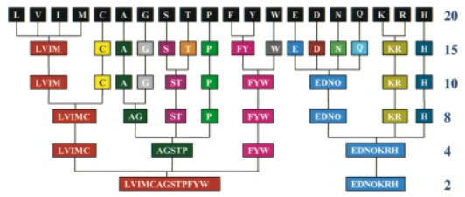
Reduced Alphabet Encoding

Slide 13
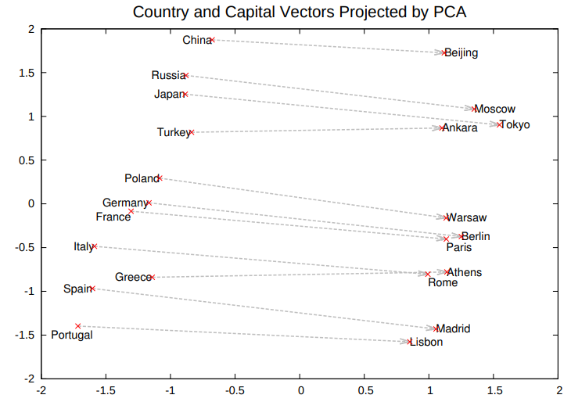
Word2Vec countries and capital cities

Slide 14
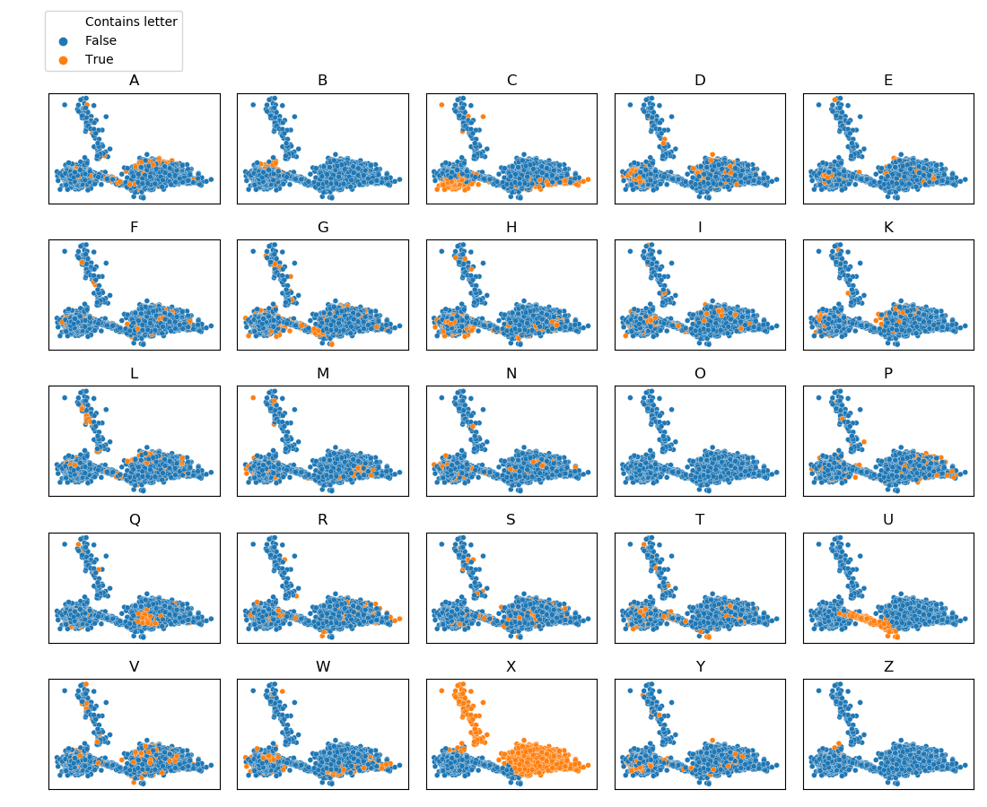
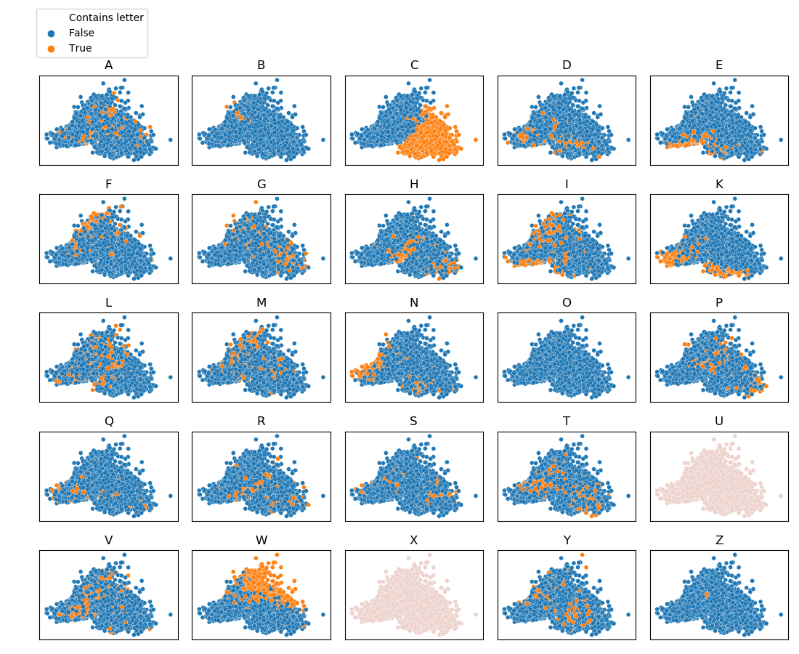
Word2Vec 3-mer PCA projections

Slide 15
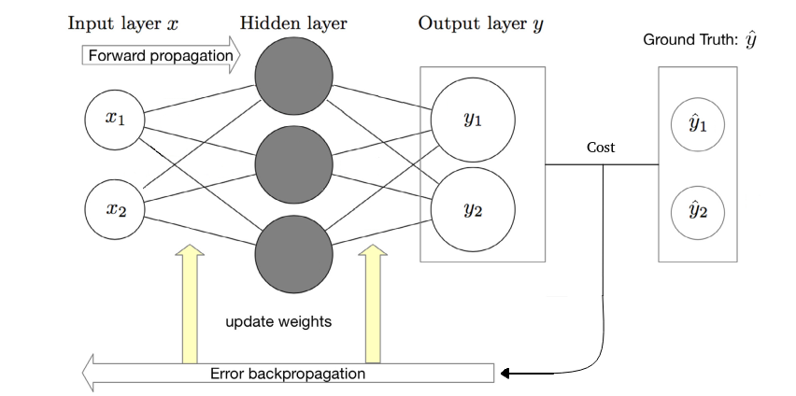
Deep Neural Network
Multiply input with weights and add biases
Sum in next node
Activate node
Gradient of cost function with respect to weights and biases
Back-propagate through network
Step in the opposite direction of the gradient to minimize cost

Slide 16
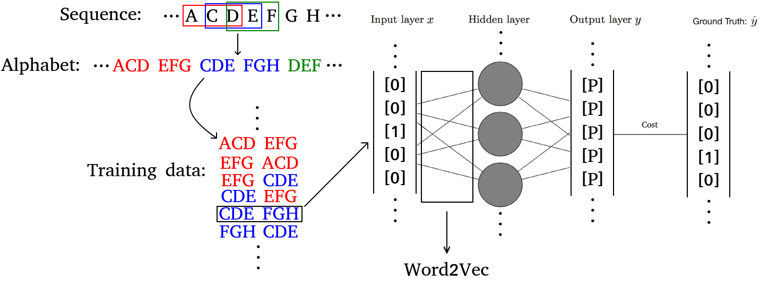
The Word2Vec architecture

Slide 17
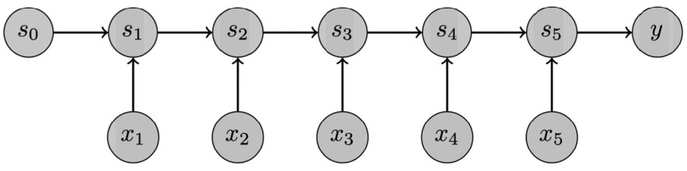
ELMo Embedding
Recurrent Neural Network

Slide 18
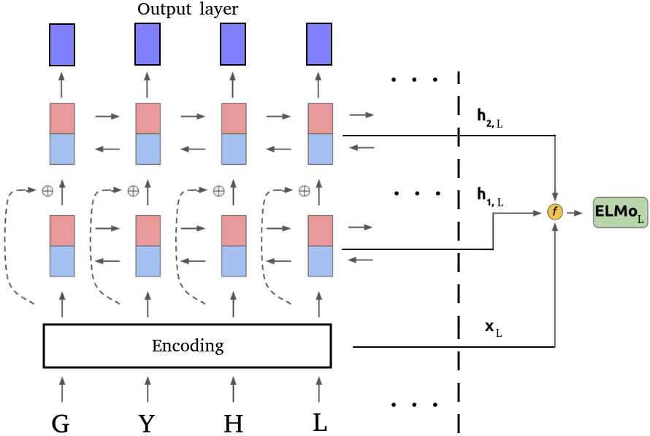
ELMo architecture
Sum?
Authors picked
convolutional network

Slide 19
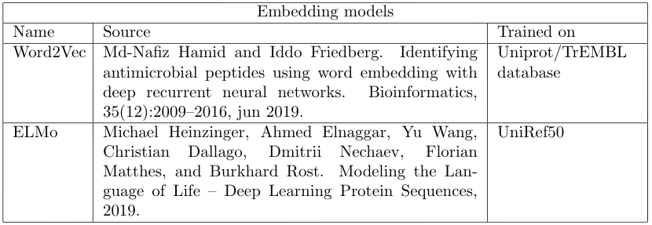

Slide 20
Contents
Part 1
Searching for good encodings
Selecting best encodings
Part 2
Combining encodings with neural networks
Part 3
Applying the model

Slide 21
Encoding selection
Similar data set
Linear support vector machine
Cross validation procedure with # folds = 10
Goal: Select encodings to move forward with

Slide 22
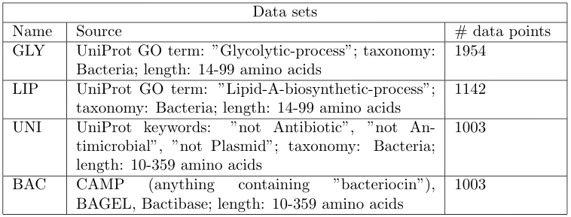
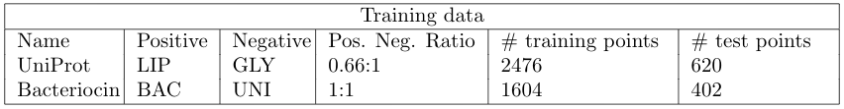

Slide 23
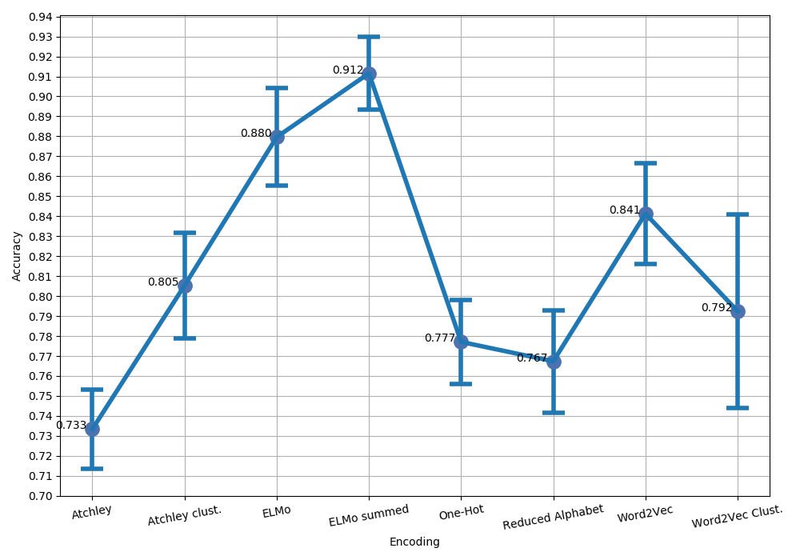
UniProt data set cross validation accuracy

Slide 24
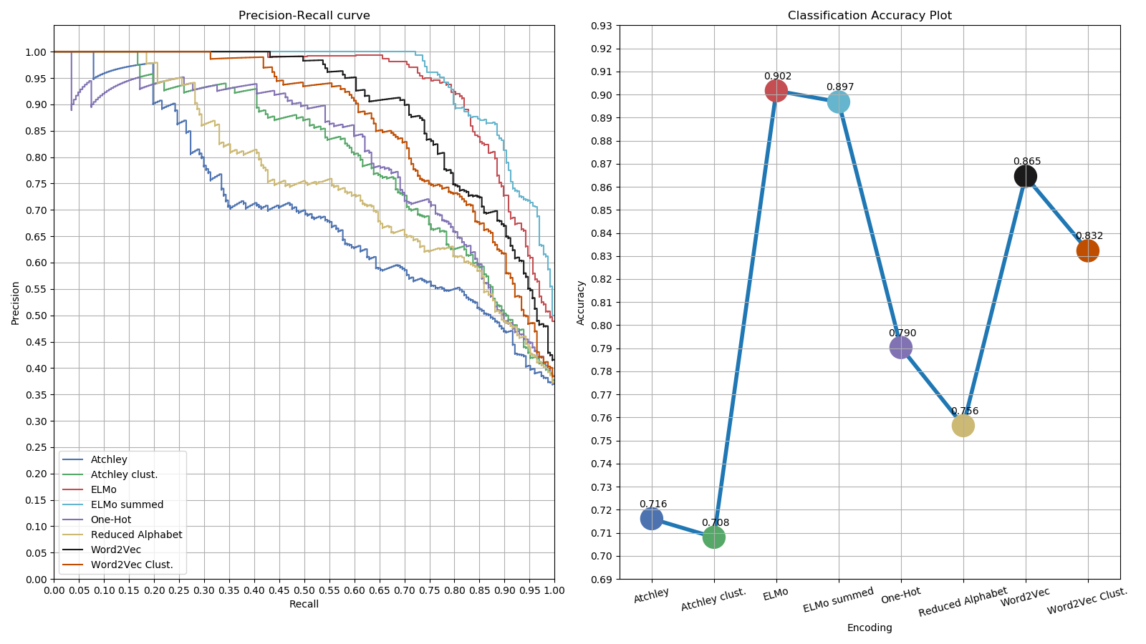
UniProt data set test accuracy

Slide 25
UniProt data set accuracy
Word embedding encodings best performance
Summing ELMo similar to not summing
Clustering Word2Vec decreases performance

Slide 26
Contents
Part 1
Searching for good encodings
Selecting best encodings
Part 2
Combining encodings with neural networks
Part 3
Applying the model

Slide 27
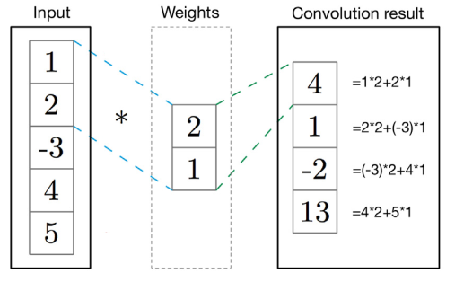
Convolutional neural network
Single filter
Kernel size 2
Stride of 1
Inner matrix product
“Compresses” information

Slide 28
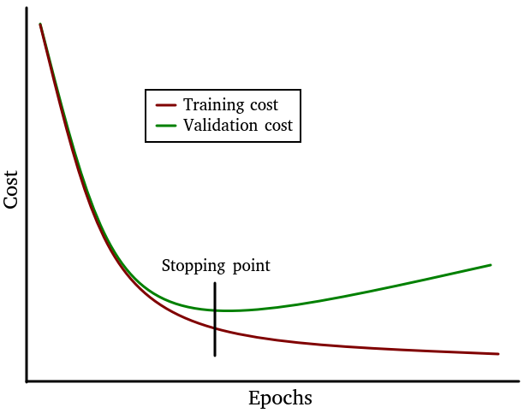
Preventing overfitting
Early stopping
Dropout
Regularization

Slide 29
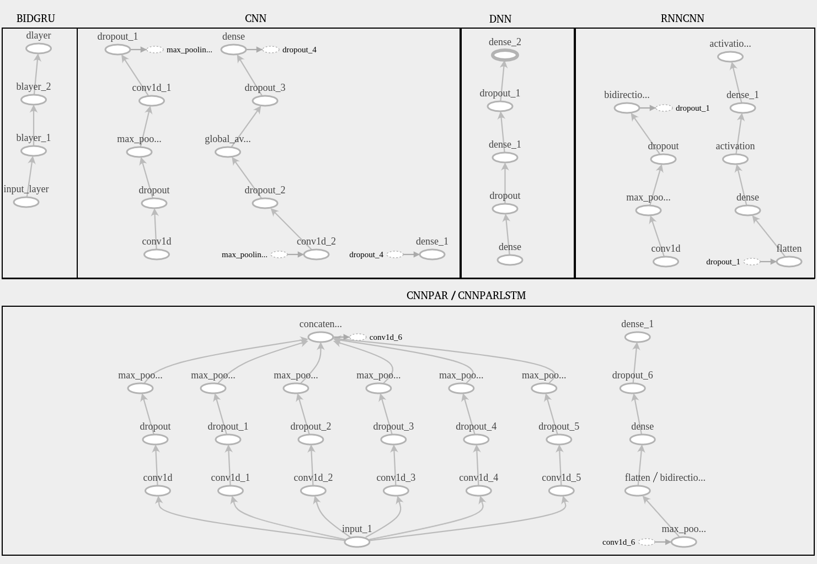
NN architectures
Hamid et al

Slide 30
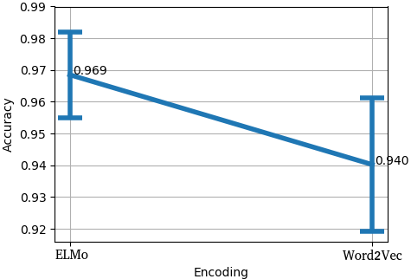
BIDGRU UniProt cross validation accuracy

Slide 31
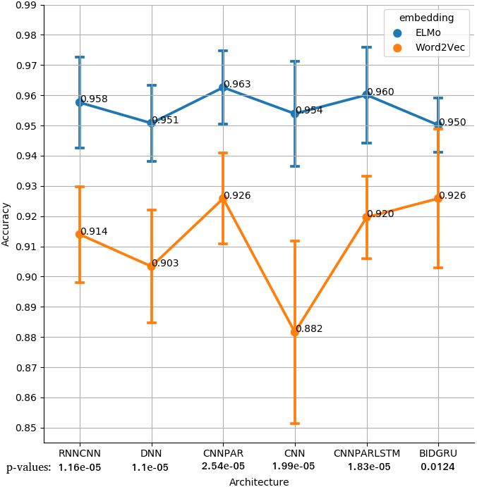
Bacteriocin data set cross validation accuracy

Slide 32
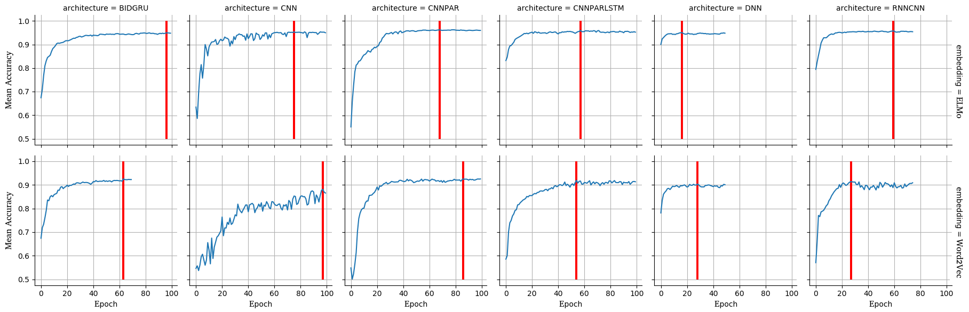
Mean accuracy per epoch

Slide 33
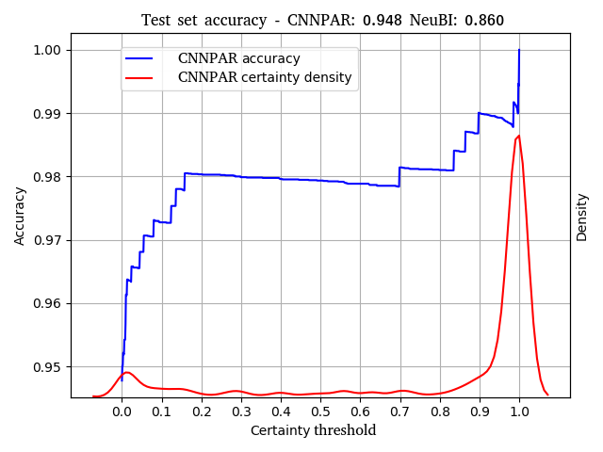
CNNPAR bacteriocin data set test accuracy
CNNPAR accuracy of 94.8%
> 98% with certainty > 0.8
NeuBI accuracy of 86.0%

Slide 34
Contents
Part 1
Searching for good encodings
Selecting best encodings
Part 2
Combining encodings with neural networks
Part 3
Applying the model

Slide 35
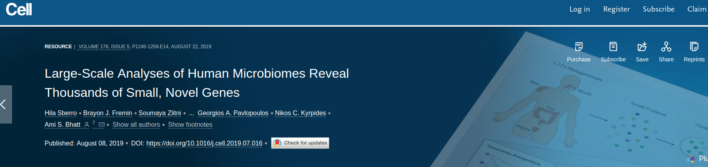
Application on Sberro’s small protein families
Human microbiome samples
~4500 small protein families < 50 AAs long
39 AMPs identified with AmPEP

Slide 36
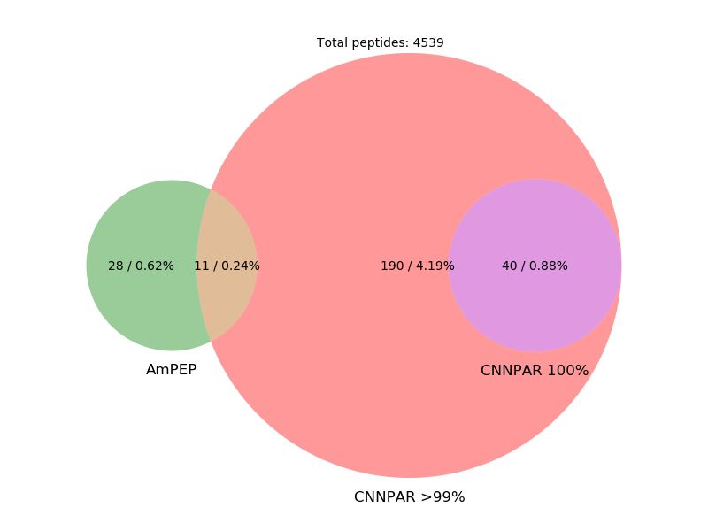
Application on Sberro’s small protein families
More bacteriocins than AMPs
Broader class classifier harder to train?

Slide 37
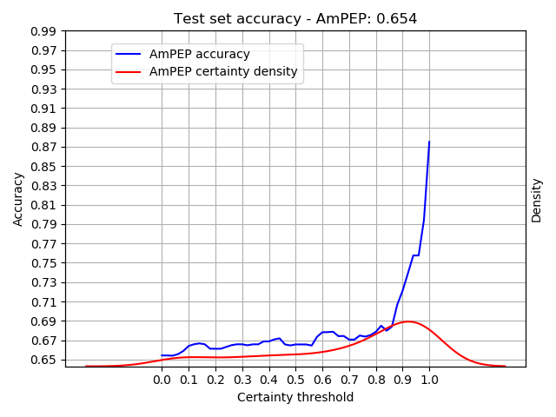
AmPEP bacteriocin data set test accuracy
Maximum certainty observed in Sberro
Normalized certainty

Slide 38
AmPEP bacteriocin data set test accuracy
AmPEP < ~67% accuracy
Conclusion: AmPEP is not good for identifying bacteriocins
Maximum certainty observed in Sberro

Slide 39
Main findings
Increased accuracy with ELMo embedding.
Hamid et al. test accuracy 86.0%.
Our classifier test accuracy 94.8%.
Found 40 putative bacteriocins.

Slide 40
The End

Slide 41
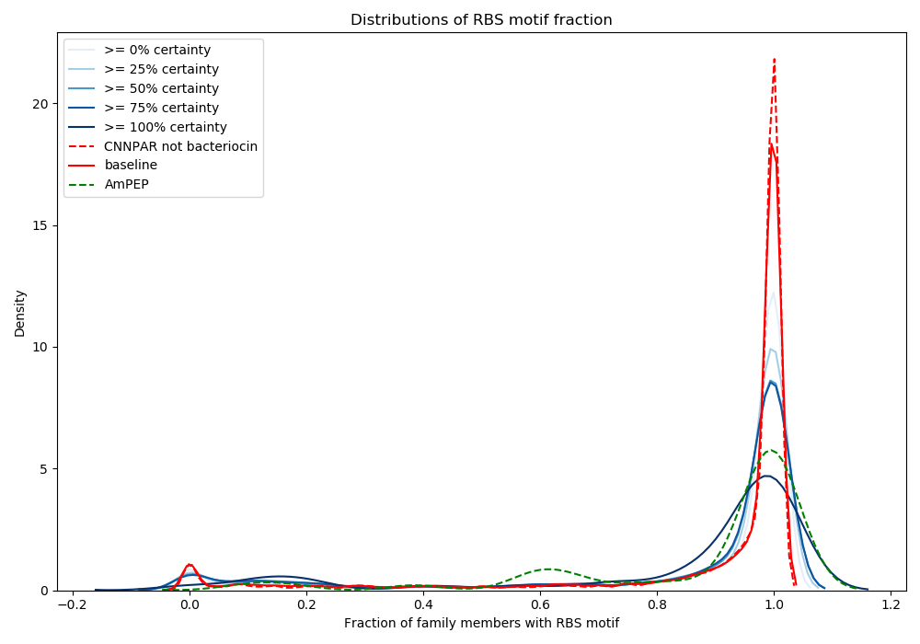
Distribution of ribosomal binding site fractions

